Slide 1
LES PARAMETRES EVIDENTIELS, INFERENTIELS ET MODAUX APPLIQUES A L’ETUDE DE MUST EPISTEMIQUE

Slide 2
Figure 1 : évidentialité directe et indirecte

Slide 3
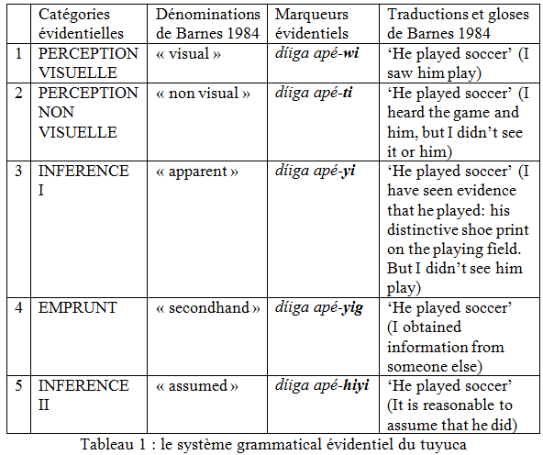

Slide 4
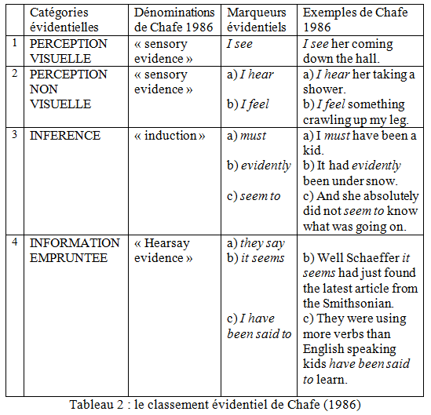

Slide 6
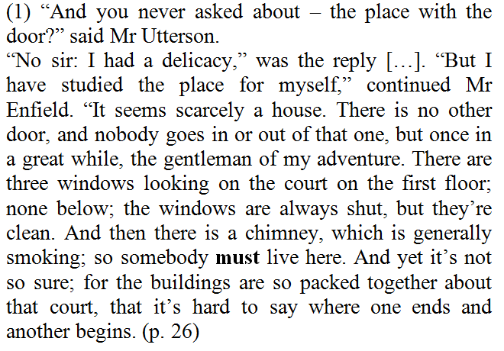

Slide 7
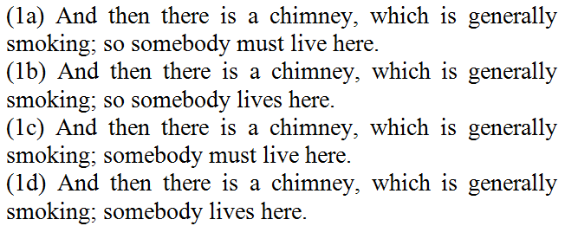

Slide 8
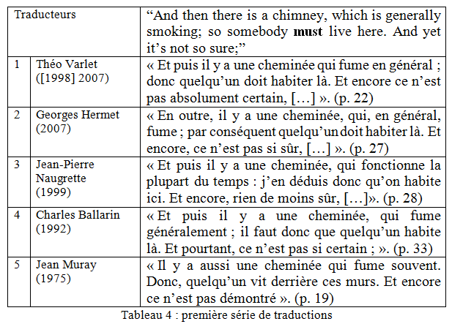

Slide 9
(2) The lawyer stood awhile when Mr Hyde had left him, the picture of disquietude. Then he began slowly to mount the street, pausing every step or two, and putting his hand to his brow like a man in mental perplexity. This problem he was thus debating as he walked was one of a class that is rarely solved.
Mr Hyde was pale and dwarfish; he gave an impression of deformity without any namable malformation, he had a displeasing smile, he had borne himself to the lawyer with a sort of murderous mixture of timidity and boldness and he spoke with a husky whispering and somewhat broken voice, – all these were points against him; but not all of these together could explain the hitherto unknown, disgust, loathing and fear with which Mr Utterson regarded him. “There must be something else,” said the perplexed gentleman. “There is something more, if I could find a name for it. God bless me, the man seems hardly human! Something troglodytic, shall we say? or can it be the old story of Dr Fell? Or is it the mere radiance of a foul soul that thus transpires through, and transfigures its clay continent? The last, I think; (p. 45-46).

Slide 10
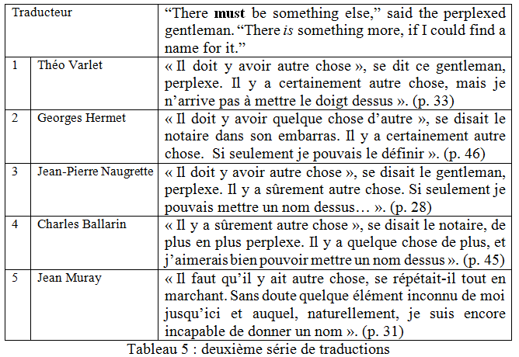

Slide 11
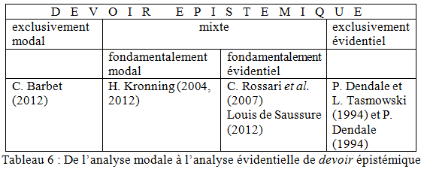

Slide 12
